Slide 1
FS : ECE & EIE
DAY 3

Slide 2
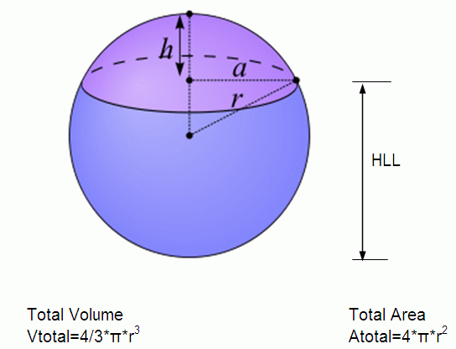
WAP to find Volume and Surface are of a sphere. Radius of sphere to be taken as input.

Slide 3
WAP to find Volume and Surface are of a sphere. Radius of sphere to be taken as input. Volume and Area should be computed in volume() and area() functions defined in a different class called Sphere
import java.util.Scanner;
class FsA6 //Volume and Surface Area Of Sphere
{
private static double r;
public static void main(String args[])
{
Scanner s= new Scanner(System.in);
System.out.println("Enter the radius of sphere:");
r=s.nextDouble();
Sphere sph = new Sphere();
sph.volume(r);
sph.area(r);
}
}
Above code should be saved in FsA6.java
On compilation creates FsA4.class
class Sphere
{
private double volume, area;
public void volume(double rad)
{
volume= (4*22*rad*rad*rad)/(3*7);
System.out.println("Volume is:" +volume);
}
public void area(double rad)
{
area= (4*22*rad*rad)/7;
System.out.println("Surface area is:" + area);
}
}

Slide 4
Java Programming
Java is an Object-Oriented Language. Java supports the following fundamental concepts:
Polymorphism (static & dynamic)
Inheritance
Encapsulation
Abstraction
Classes
Objects
Instance
Method
Message Passing

Slide 5
Approximate Terminology
instance = object
field = instance variable
method = function
sending a message to an object = calling a function
These are all approximately true

Slide 6

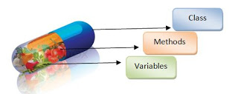
Java Programming - Encapsulation
Java – Encapsulation
Encapsulation is also known as “data Hiding”.
Word encapsulation has been derived from Capsule

Slide 7
Java Programming – Unit 1
Java - Encapsulation
Encapsulation in Java is a mechanism of wrapping the data members(class variables) and code acting on the data ie member functions(methods) together as single unit.
In encapsulation the data members of a class will be hidden from other classes, and can be accessed only through the methods of their current class.
Encapsulation is process of wrapping code and data together into a single unit.
Encapsulation is also known as "Data hiding" because they are protecting data which is prone to change.

Slide 8
Java Programming – Unit 1
The benefits of encapsulation are:
Encapsulation promotes maintenance
Code changes can be made independently
Increases usability for clients.
Makes it easy to model real-world entities – hence easy to understand and maintain
Control the way data is accessed or modified
And encapsulation is implemented with:
Public interfaces
controls of visibility of operations & state
data is private / not accessible

Slide 9
Java Programming : Constructor
Constructors in Java
Constructor is a block of code and is also called a special method.
Constructor gets created when you use new keyword in order to instantiate an object.
It is a special method for following reasons:
Name of the constructor is same as class name. Including case.
Methods have return type but constructors don’t have any return type.
It is created with new operator.
It may or may not have parameters.

Slide 10
Java Programming : Constructor
How to call a constructor?
The constructor gets called when we create an object of a class (i.e. new keyword followed by method whose name is same as class name).
For e.g.
Demo obj = new Demo();
Here Demo() is a default constructor of Demo class.
Default constructor:
It is also known as no-arg constructor. Constructor with no arguments is known as default constructor.
Meant for assigning default values to data members.
class Demo
{
public Demo()
{
System.out.println("This is a default constructor");
}
}

Slide 11
Java Programming : Constructor
What if we don’t define a constructor?
class Example
{
public void demoMethod()
{ System.out.println("hello"); }
public static void main(String args[])
{
Example obj = new Example();
obj.demoMethod();
}
}
But where did I defined the constructor?
If you don’t define the constructor, compiler creates one for you.

Slide 12
Java Programming : Constructor
Parameterized constructor.
Parameterized constructor can have one or more than one parameters.
We can invoke parameterized constructor by passing parameters of appropriate data type while creating object.

Slide 13
Java Programming : Constructor
class FsJavaDd2
{
private int var1,var2;
public FsJavaDd2()
{ //code for default one
var2 = 10;
}
public FsJavaDd2(int num)
{ //code for parameterized one
var1 = num+10;
}
public static void main(String args[])
{
FsJavaDd2 obj1 = new FsJavaDd2();
System.out.println("var1 = "+obj1.var1 + " var2 = "+obj1.var2);
FsJavaDd2 obj2 = new FsJavaDd2(obj1.var1);
System.out.println("var1 = "+obj2.var1 + " var2 = "+obj2.var2);
}
}

